Slide 1



Problem Solving Concepts
Fred Nickols
A Webinar for Faculty at University of Arkansas, Pine Bluff
April 9, 2020

Slide 2



About Fred Nickols

Slide 3












Slide 4




Slide 5
Overview
Why I’m Here
Faculty Challenges
Experts vs Novices
Four Factors
Categories of Problems
Basic Concepts
Intelligence Work
General Form of the Solution
A Problem as a Gap
Five Kinds of Gaps
Three Basic Approaches
Positions People Take
Solution-Execution Matrix
Solution Quality
Ten Tips
Concluding Remarks

Slide 6
Why I’m Here
Phases | Capstone 4 | Milestone 3 | Milestone 2 | Benchmark 1
Define the Problem | The quality of the problem statement and the coverage of the relevant contextual details
Identify Strategies | The number of approaches identified and their fit within a specific context
Propose Solutions | The number and quality of the solutions proposed and their fit with the definition of the problem and the contextual factors
Evaluate Solutions | The quality of the evaluation of the solutions, especially their depth and thoroughness
Implement Solution | The depth and thoroughness with which the implementation addresses the contextual factors
Evaluate Outcomes | The extent to which the review of results addresses the problem defined and the need for additional work

Slide 7
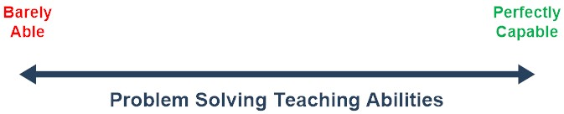

Challenges

Slide 8
A Distribution Like This?

Slide 9
Or Like This?

Slide 10
Or This?

Slide 11
More Challenges
Becoming Better Problem Solvers Yourselves
Mastering Problem-Solving Pedagogy
Mastering the Problem-Solving Body of Knowledge
Learning to Use Various Tools & Techniques
Integrating Problem Solving into Your Teaching
Devising Problem-Solving Assignments
Ensuring that the PSVR is a Valid, Useful Tool

Slide 12

Expert vs Novice
Has a thorough understanding of the structure of the situation and the nature of the problem

Slide 13
Four Factors

Slide 14
Categories of Problems
attitude problems
attendance problems
business problems
capacity problems
communication problems
control problems
feedback problems
financial problems
hardware problems
health problems
legal problems
management problems
measurement problems
morale problems
operational problems
organizational problems
performance problems
personal problems
personnel problems
political problems
production problems
productivity problems
psychological problems
quality problems
resource problems
staffing problems
systems problems
training problems

Slide 15
Financial Structures
15

Slide 16
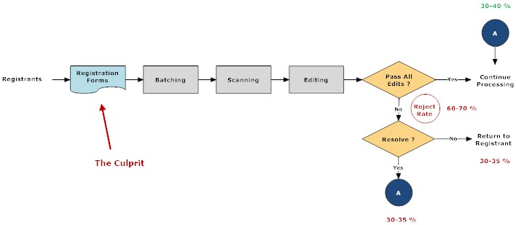
Operational Structures

Slide 17
Behavioral Structures

Slide 18
Organizational Structure

Slide 19
Basic Terms
Problem
  A problem exists when action is required but the action to take is not immediately apparent
Solution
  A solution is a course of action that, once carried out, brings about the desired state of affairs
Problem Solving
  The process of figuring out what to do
Solving Problems
  Bringing about the desired state of affairs

Slide 20

It’s Intelligence Work

Slide 21


It’s A Search Activity

Slide 22
General Form
Load Rate – Better Use of Space
Claims Examiners – Eliminate Time-Wasters
Correspondence Unit – Productivity Rules

Slide 23
Problem as A Gap

Slide 24
Five Kinds of Gaps
Something’s Gone Wrong
Raised Expectations
Double Whammy
Never Did Work Right
Build It from Scratch

Slide 25
Something’s Gone Wrong

Slide 26
Raised Expectations

Slide 27
Double Whammy

Slide 28
Never Did Work Right

Slide 29
Build It from Scratch

Slide 30
Three Basic Approaches

Slide 31
Positions People Take

Slide 32
Solution Execution Matrix

Slide 33
Solution Quality

Slide 34
Ten Problem-Solving Tips
Focus on the Solved State
Be Clear about ALL Your Goals & Objectives
Expand Your Definition of “Define the Problem”
Think of Problem Solving as a “Cover the Bases” Activity
Draw Diagrams & Otherwise Picture the Structure of the Problem
Take the Concept of “Cause” with a Grain of Salt
Watch Out for “Disconnects”
Be Aware of Your Own Blinders
Develop Your Own System for Solving Problems
Research the Subject Matter

Slide 35

Focus

Slide 36
Be Clear

Slide 37
Expand “Define”

Slide 38
Cover the Bases

Slide 39
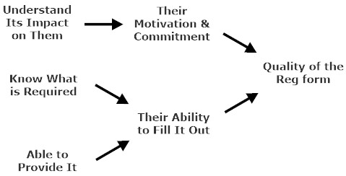
Draw Diagrams

Slide 40

Beware of “Cause”

Slide 41

Beware of “Disconnects”

Slide 42

Be Aware of Your Blinders

Slide 43

Devise Your Own System

Slide 44

Do Your Research

Slide 45
Wrap Up Discussion

Slide 46
My Contact Information
Fred Nickols
Managing Partner
Distance Consulting, LLC
“Assistance at a Distance”
922 Country Club Drive
Howard, OH 43028
fred@nickols.us
www.nickols.us
(740) 504-0000
“My Objective is to Help You Achieve Yours”

Slide 47
Concluding Remarks

